Slide 1
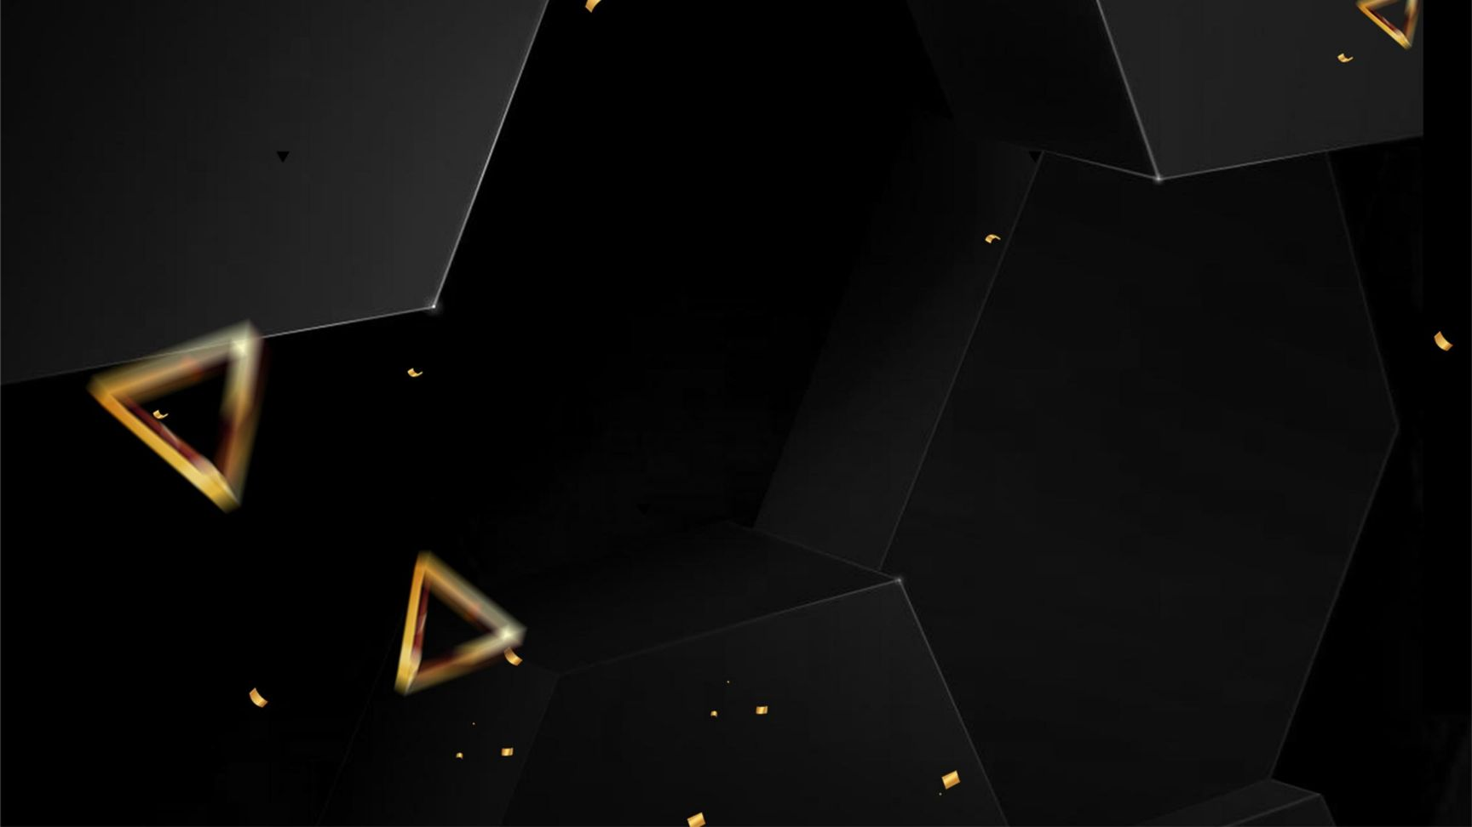
On-Device Real-Time Zonal Obstacle Detection and Audio-Haptic
Feedback for the Visually Impaired
B.Tech Artificial Intelligence & Data Science
Jayalakshmi Institute of Technology
Presented by:
M. Gowtham (610922243009)
D. Karthick (610922243013)
R. Ramakrishnan (610922243033)
S. Raman (610922243034)
Guided by:
R.Karthik AP/AI&DS

Slide 2


Contents
Problem & Motivation
Objectives & Edge AI
Architecture & Hardware
Software & Optimization
Working & Logic
Results & Feedback
Conclusion & Future

Slide 3
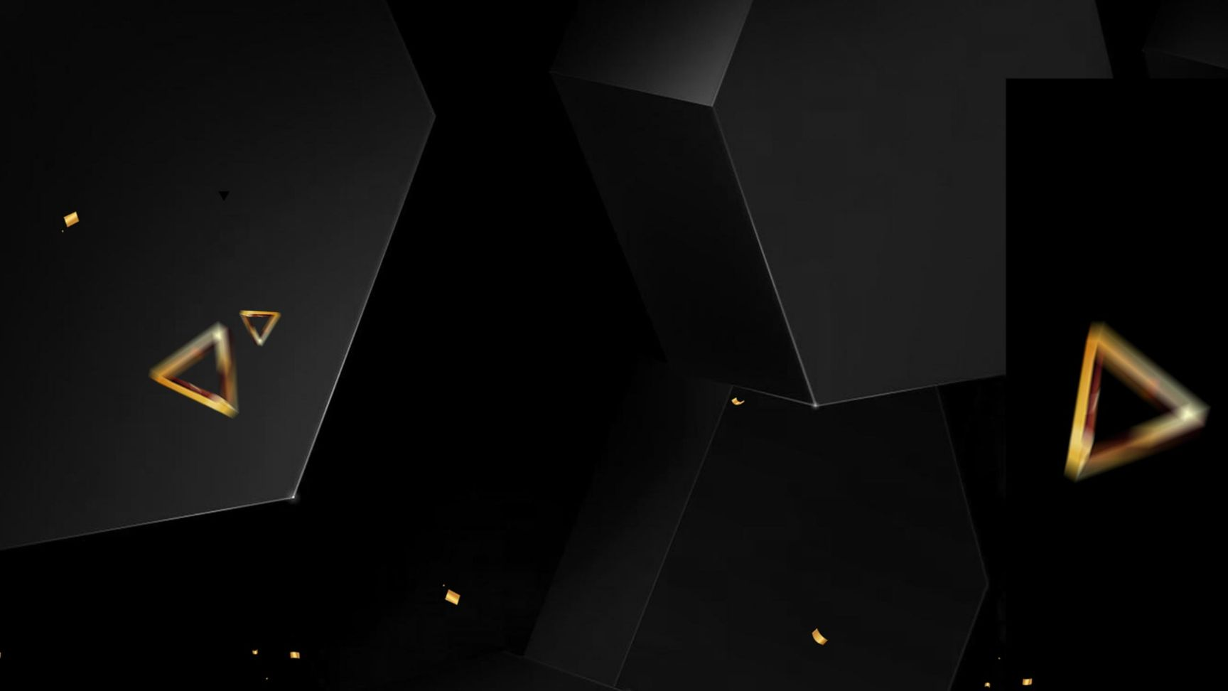
PART 01
Motivation & Problem Statement
Understanding the real-world navigation challenges

Slide 4
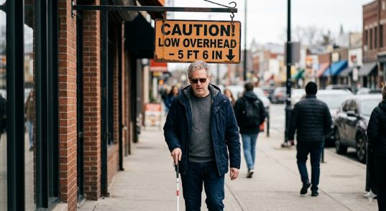
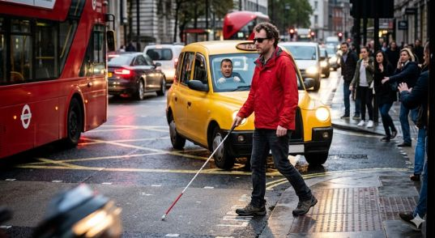
The Challenge for Visually Impaired Individuals
Independent Mobility🚶Limitations
High-Risk Collision Scenarios
Traditional tools like white canes only detect ground-level obstacles,
Cannot detect elevated obstacles
Misses moving objects
Limited awareness in crowded areas
⚠️High risk of upper-body collisions
Waist-level obstacles not detected
Unsafe in real-world environments

Slide 5
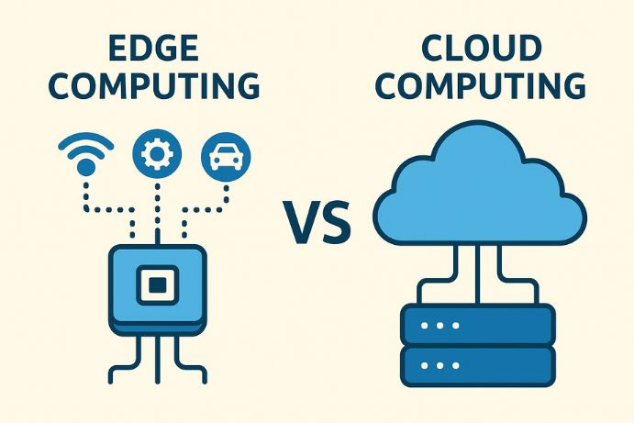
Limitations of Current AI Systems
☁️Cloud AI Dependency Issues
Relies on cloud☁️ processing
High latency ⏳(delay in response)
Requires constant internet📶
Privacy🔒 and data security concerns
❌ Not suitable for real-time assistive navigation

Slide 6
PART 02
Objectives & Edge AI
Why Edge AI is the right solution

Slide 7
Core System Objectives
01
02
03
Real-Time Detection
Offline Edge AI
Multi-Modal Feedback
Detect obstacles in real time
Wearable and portable system
Improves user awareness
100% on-device processing
No internet required
Low latency and fast response
Audio alerts and vibration for guidance
Easy and intuitive navigation
🎯
⚡
🔊

Slide 8
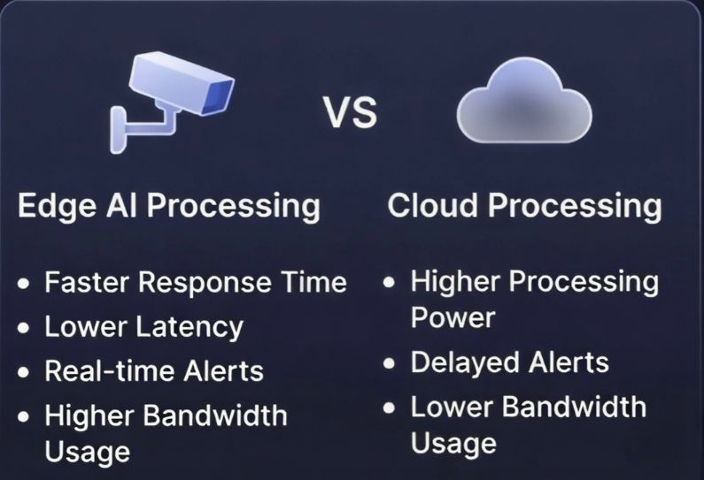
Why Edge AI is Essential
Cloud VS Edge Processing Comparison
No internet dependency
Ultra-low latency (fast response)
Real-time alerts
Better privacy and security
✅ Best choice for real-time assistive navigation

Slide 9
PART 03
Architecture & Hardware

Slide 10
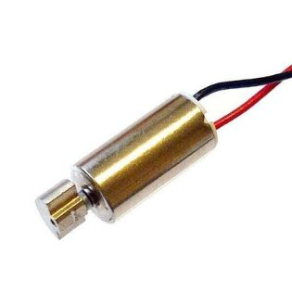
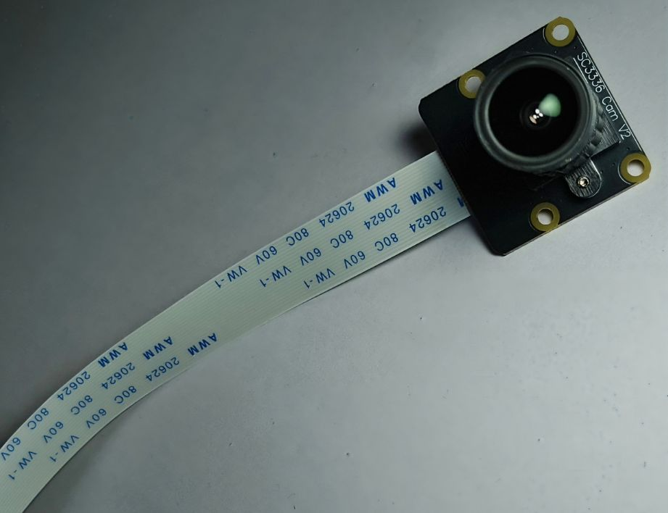
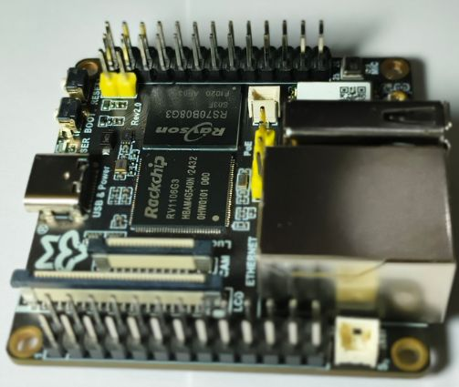
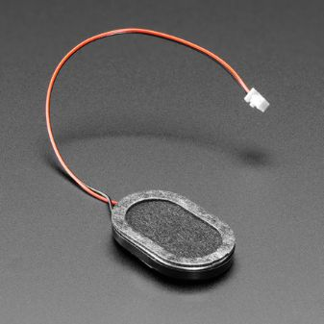
Overall System Architecture
Camera → AI Model (NPU) → Spatial Logic → Audio & Vibration Output
+
→
→
Camera → Input
Board → Processing (NPU)
Motor + Speaker → Output

Slide 11
Hardware Specifications
Component | Specification
Camera📷 | waveshare SC3336 (3MP, 1080p)
Processor Board🧠 | Luckfox Pico Ultra (RV1106, ARM Cortex-A7 + NPU 0.5 TOPS)
Audio Output | 8 Ω Speaker🔊
Haptic Feedback | Vibration motor📳
Power Supply | 5V Battery / USB

Slide 12
PART 04
Software & Optimization

Slide 13
Software & Technology Stack
01
02
Operating System and Programming
AI Model and Optimization Tools
Buildroot Linux (custom OS)
Python for control & AI pipeline
Lightweight embedded system
YOLOv8-Nano (object detection)
Optimized for edge devices
RKNN Toolkit2 for NPU
Fast and low-latency inference

Slide 14
AI Model Optimization with INT8 Quantization
01
02
Model Compression Strategy
Optimization Results
YOLOv8-Nano model used
Converted to ONNX format
Applied INT8 quantization
Optimized using RKNN Toolkit
Reduced model size
Faster inference speed
Maintains good accuracy
Suitable for real-time edge use

Slide 15
PART 05
Working & Logic

Slide 16


Step-by-Step Working Pipeline
Inference and Spatial Logic
Step 3: Run YOLOv8-Nano (NPU)
Step 4: Extract bounding boxes
Step 5: Spatial logic (-left|-center-|right-)
Step 6: Output alerts (Audio + Vibration via GPIO)
Image Capture and Preprocessing
Step 1: Capture image (SC3336 Camera)
Step 2: Preprocess (resize, normalize)

Slide 17
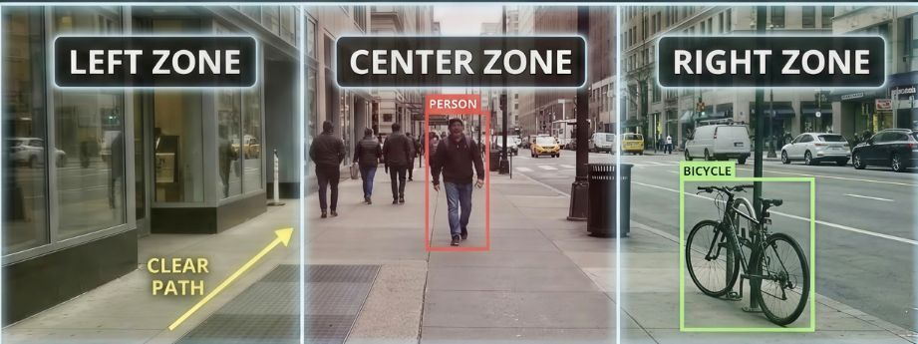
3-Zone Spatial Directional Mapping
Camera frame is divided into 3 zones:
Left Zone
Center Zone
Right Zone
Zone Division Logic
Alert Priority:
Center → High (danger)
Left / Right → Medium
Alert Priority

Slide 18
PART 06
Results & Feedback

Slide 19
Multi-Modal Feedback Mechanism
Haptic and Audio Cues
Left → short vibrations 📳 + voice🔊 guidance
Right → short vibrations 📳 + voice🔊 guidance
Center → Continuous vibration 📳 + voice🔊 guidance

Slide 20
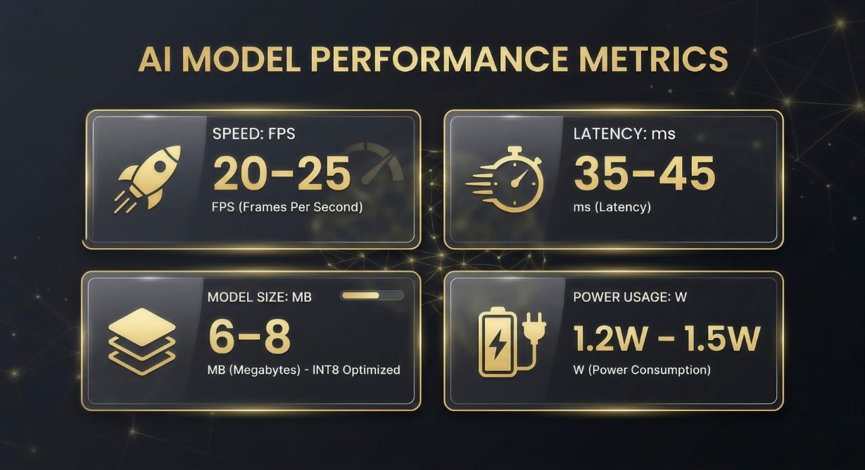

Experimental Results and Metrics
Performance Metrics
Latency: 35–45 ms per frame
Speed: 20–25 FPS (real-time)
Model size: 6–8MB (INT8 optimized)
Power usage: 1.2W – 1.5W

Slide 21
PART 07
Conclusion & Future

Slide 22
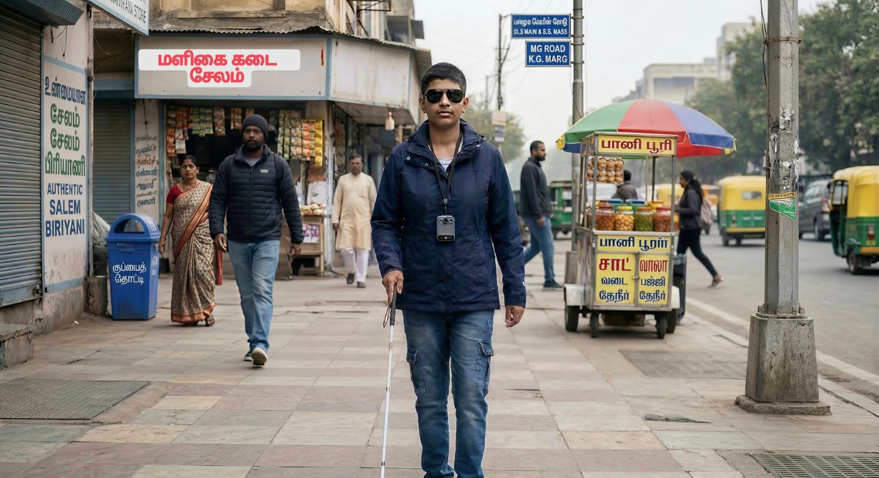
Project Conclusion
Success Demonstration
“Our system uses Edge AI with INT8 optimization to enable real-time, low-latency obstacle detection, with the goal of creating a safer environment for visually impaired users to navigate independently.”

Slide 23
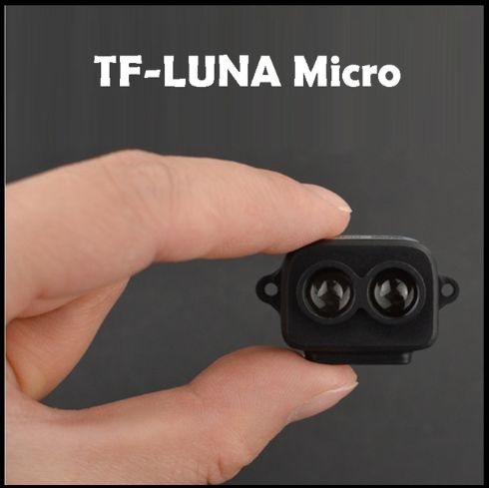

Future Scope
Sensor Integration and Connectivity
Future scope includes integrating LiDAR sensors for accurate depth sensing, along with GPS-based navigation and smartphone connectivity for enhanced real-time assistance.

Slide 24
Thank you for your support

